Slide 1

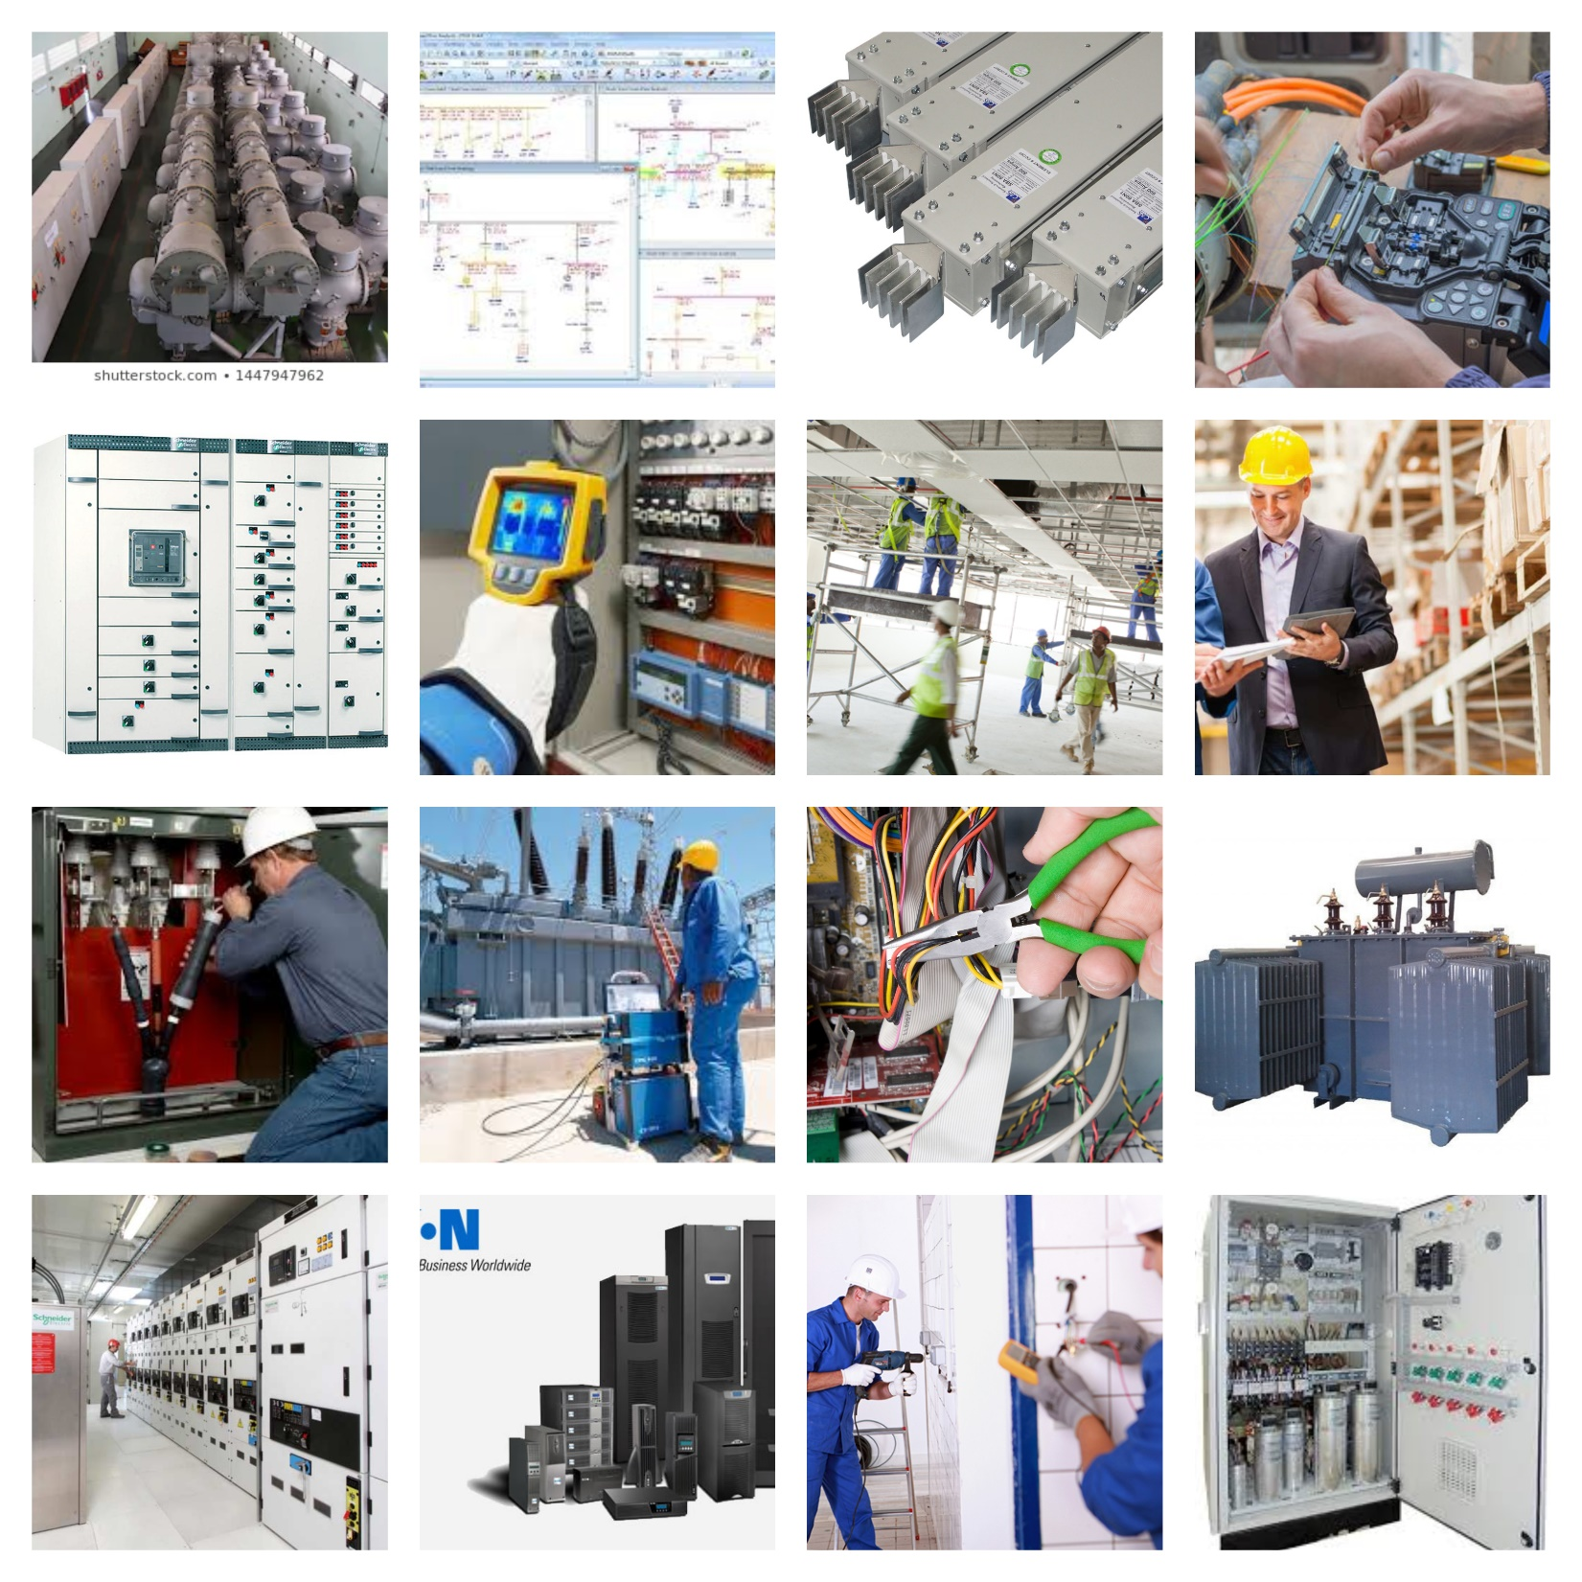

Business Plan
April-2024
License No: 1324008
( Expiry 13-Mar-2025)

Slide 2




ELFA ENERGY Electromechanical Contracting
Executive Summary:
ELFA Energy Contracting is a specialized service provider in Electrical Contracting and Maintenance & Services. Our core services include the installation of switchgears, SMDBs, AC DC Distribution panels, MEP Works, Installation of cable trays, MV/LV Cable laying and termination works.
We offer end-to-end solutions encompassing Supply, Installation, Testing & Commissioning, AMCs, and Modification works. Our commitment to innovation and quality positions us as a leader in the industry, contributing significantly to the economy and society.

Slide 3
ELFA ENERGY Electromechanical Contracting
Company Description:
ELFA Energy Contracting is dedicated to delivering high-quality electrical contracting services to commercial, industrial, and residential clients. With a team of skilled professionals and cutting-edge technology, we ensure efficient and reliable solutions tailored to meet the unique needs of each project. Our expertise covers a wide range of services, including:
Installation of switchgears, SMDBs, AC DC Distribution panels
MEP Works
Installation of cable trays
MV/LV Cable laying and termination works
Supply, Installation, Testing & Commissioning
Annual Maintenance Contracts (AMCs)
Modification works

Slide 4
ELFA ENERGY Electromechanical Contracting
Market Analysis:
The demand for reliable and efficient electrical services is constantly growing, driven by factors such as urbanization, industrialization, and technological advancements. ELFA Energy Contracting targets this growing market by offering comprehensive solutions that prioritize quality, safety, and sustainability. Our focus on innovation and customer satisfaction gives us a competitive edge in the industry.
Marketing and Sales Strategy:
Our marketing strategy revolves around establishing strong relationships with clients, emphasizing our reputation for quality and innovation. We utilize various channels, including online platforms, industry events, and referrals, to reach potential customers and showcase our expertise. Additionally, we offer personalized solutions and flexible service packages to cater to diverse client needs.

Slide 5

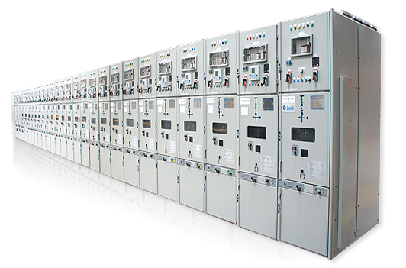
OUR SERVICES
ELFA Energy Electromechanical
1. Contracting Division
2. Maintenance Division
Retrofit, Trouble Shooting & Repair, Condition Monitoring
MEP Contracting
Technical Studies (ETAP & ECODAIL)
ELV Systems & Automation
Maintenance Services, Thermography, 24/7 Call Off Services
Switchgear / Transformer Services Specialist

Slide 6
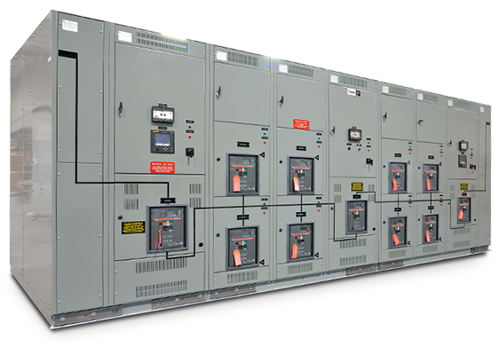
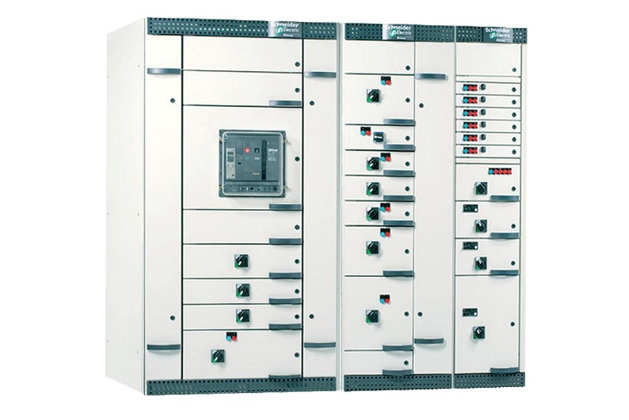
Comprehensive Switchgear Solutions
Replacement, Extension &
retrofit
Maintenance
Maintenance
Relay setting , Cooordination
Relay Setting, Cordination
Study &
Other Technical Study
Study & other technical
Study
▪ Replace Old / Obsolete Circuit ▪ Preventative, predictive ▪ To perform the relay setting
breakers with new breakers to extend the life of the panels
▪ Expansions and extensions to installed systems by adding
and corrective
maintenance services to
maximize the reliability
and availability of
equipment and systems
and coordination study as per
▪ To perform Power Quality related studies as per client’s
utility requirement
new equipment or functionality
▪ Services to evolve or upgrade Protections to next generation of Protections
▪ Service agreements ^{requirement}
Partial Discharge
Condition Monitoring
Install, Test & Commission
▪ Testing of Equipments as per utility/ client requirement
▪ Start‐up and commissioning services of new equipment and Services

Slide 7
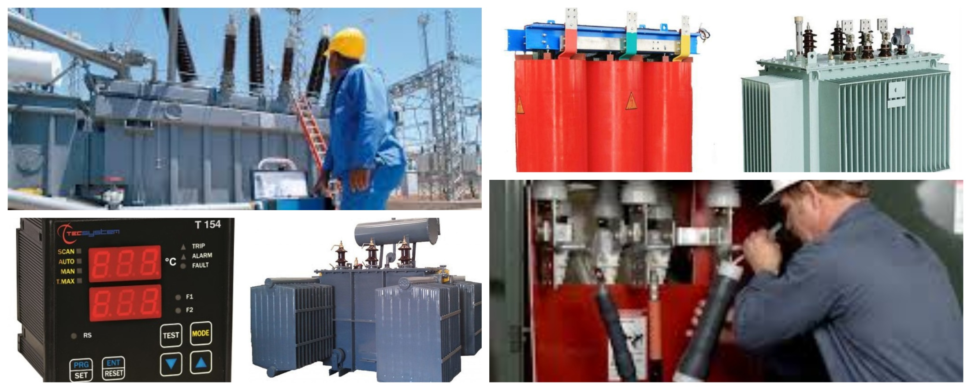
Diverse Transformer Services
Erection, Testing & Commissioning
Service agreements / AMC
Testing as per utility/ client requirement
Start‐up and commissioning services of new equipment and Services
Transformer Diagnostics & Oil filtration
Condition Monitoring & Partial Discharge
Spares Supply

Slide 8
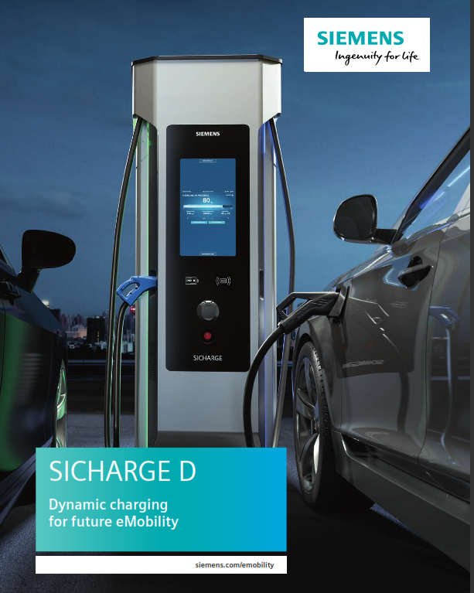
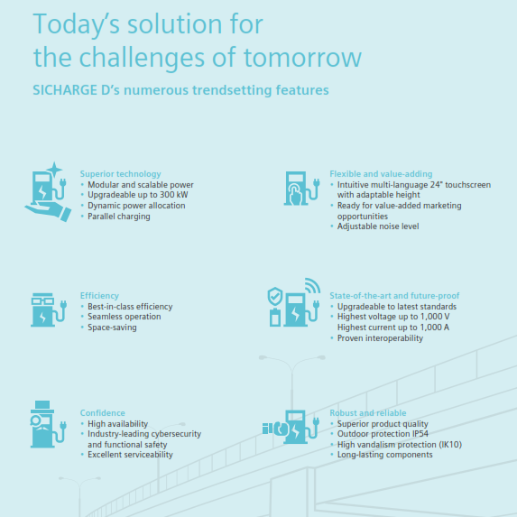
ELFA ENERGY Electromechanical Contracting
One Window Solution

Slide 9
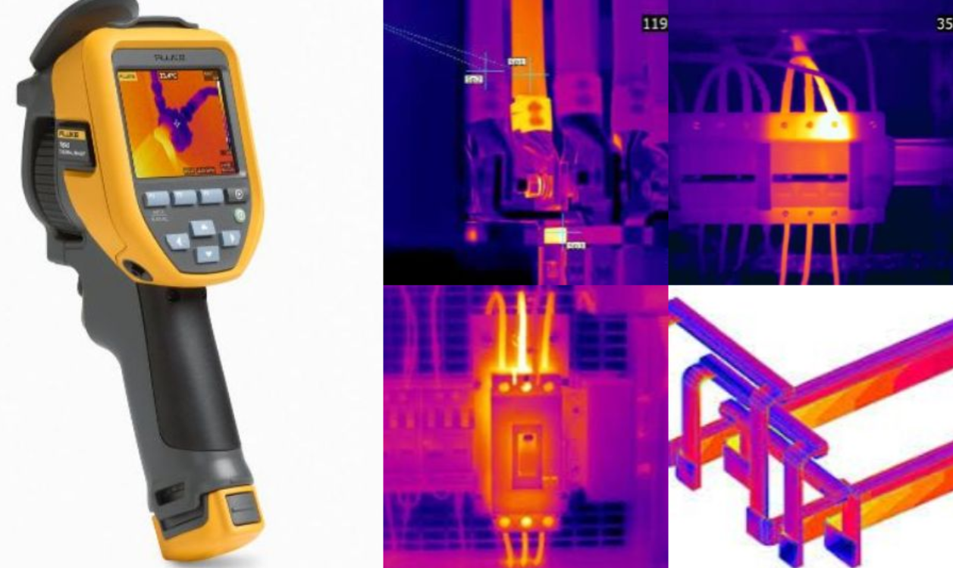
ELFA ENERGY Electromechanical Contracting
Thermography Testing for All Panel Types

Slide 10
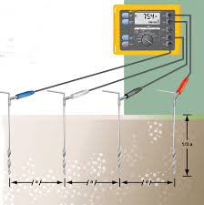
Earthing Resistivity Testing
We conduct thorough analyses of earthing/grounding networks within industrial facilities, substations, plants, or office buildings. Our services include fault detection, identifying weak points, and proposing enhancements. Upon agreement, we offer to replace, reconstruct, and commission the earthing systems to ensure optimal performance and safety

Slide 11
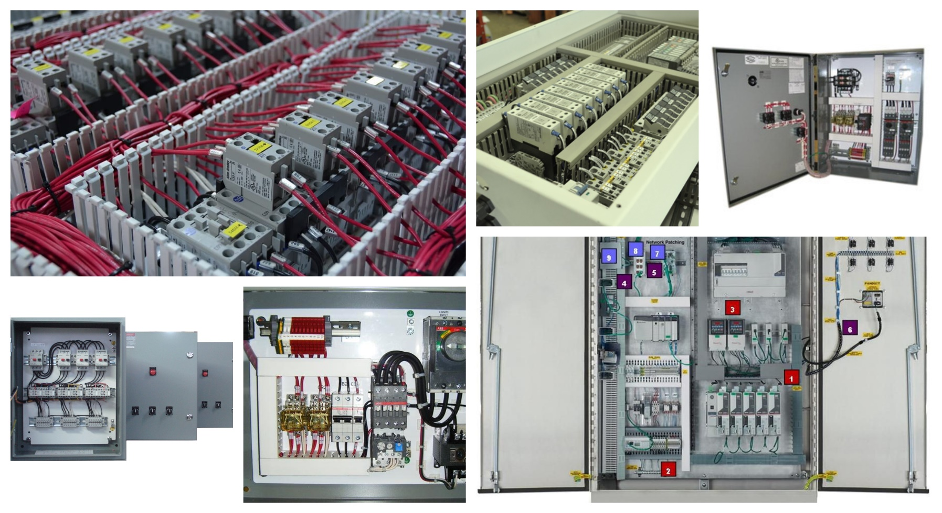
ELFA ENERGY Electromechanical Contracting
Assembly, Installation, T & C of Control Panels / SMDBs / DBs
Control Panels for various applications

Slide 12
ELFA ENERGY Electromechanical Contracting
Operational Plan:
ELFA Energy Contracting operates with a focus on efficiency, safety, and compliance with industry standards. We invest in ongoing training and development for our team members to ensure they stay abreast of the latest technologies and best practices. Additionally, we prioritize sustainability in our operations, minimizing waste and environmental impact wherever possible.
Financial Plan:
Our financial plan is based on sustainable growth and profitability. We aim to achieve steady revenue growth through a combination of new client acquisition and repeat business. By effectively managing costs and optimizing resource allocation, we ensure healthy profit margins while reinvesting in business expansion and innovation.

Slide 13
ELFA ENERGY Electromechanical Contracting
Future Outlook:
ELFA Energy Contracting is committed to continuous improvement and innovation to meet the evolving needs of the industry. We will explore opportunities for diversification and expansion into new markets while maintaining our focus on quality and customer satisfaction. Through strategic partnerships and investments in technology, we aim to solidify our position as a leader in the electrical contracting sector.
Conclusion:
ELFA Energy Contracting is poised for success in the dynamic and competitive field of electrical contracting. With our commitment to innovation, quality, and customer satisfaction, we are well-positioned to capitalize on emerging opportunities and contribute positively to the economy and society.

